Slide 1
CAPSTONE PROJECT PRESENTATION
卒業論文プレゼンテーション

Slide 2
BOOKAHOLIC SOCIAL NETWORK
Meet the team
Bookaholic Social Network
1. Introduction- 導入
Fusce som libero topi sombrero bikinan meksiko when an unknown printer took a galley of type and scrambled.

Slide 3
2. Project Management - プロジェクト管理
.

3. Software Requirement Specifition
- ソフトウェア要求仕様
4. Software Design Description - ソフトウェア設計説明書.
5. Quality Control
- 品質管理

Slide 4
6. Project Result - プロジェクト結果

7. Demo- デモ
8. Q&A - 質問と回答
End
4

Slide 5
MEET THE TEAM

Slide 6


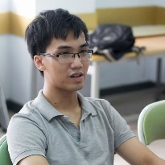

Meet the Team
NGUYEN VAN SANG
PHAM THI HUYEN
Instructor
Project Manager, Developer
Instructor
VU HAI ĐANG
NGUYEN THI HAI YEN
Technical Leader, Developer
Designer, Test Leader, QA
THAI THI CAM VAN
CHU MINH HAI
Designer Leader, Developer
Designer, Tester

Slide 7

I. Introduction
1. Current Situation - 現在状況
2. The Idea - アイデア

Slide 8






1. Current Situation - 現在状況
Nowadays, there are so many social networks such as Facebook, Zalo, etc. But there is not many social network for book lovers who enjoy to reading books, especially for Vietnamese.
8

Slide 9



2. The Idea - アイデア
Build a book social network that allows:
Book lovers and authors join together
Sharing, recommending, reviewing great books for everyone
9

Slide 10
PROJECT MANAGEMENT

Slide 11
PROJECT MANAGEMENT
Software Process Model
ソフトウェアプロセスモデル
Project Organization
プロジェクト組織
Project Schedule
プロジェクト計画
Objectives & deliverables
目標と成果物
Tools & Infrastructure
ツールと インフラストラクチャ
Risks management
リスク管理
Configuration management
コンフィグレーション管理
コミュニケーション管理
Communication management

Slide 12
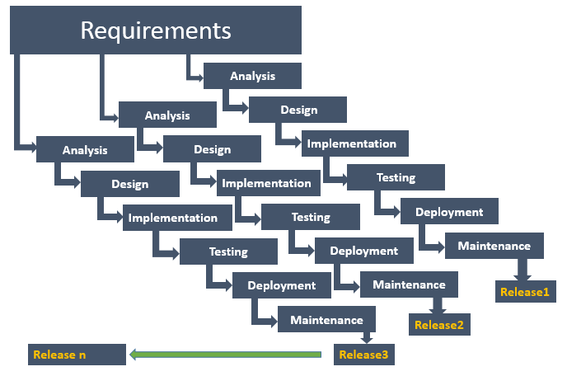
1. Software Process Model - ソフトウェアプロセスモデル

Slide 13
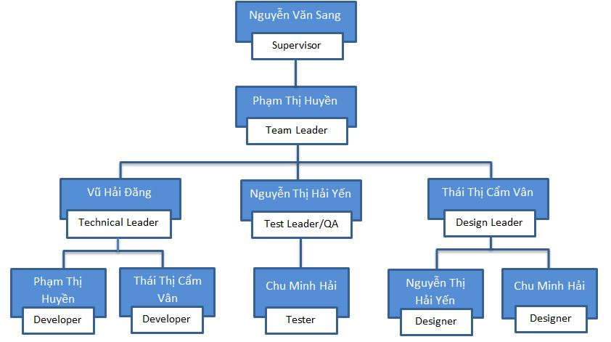
2. Project Organization -プロジェクト組織

Slide 14
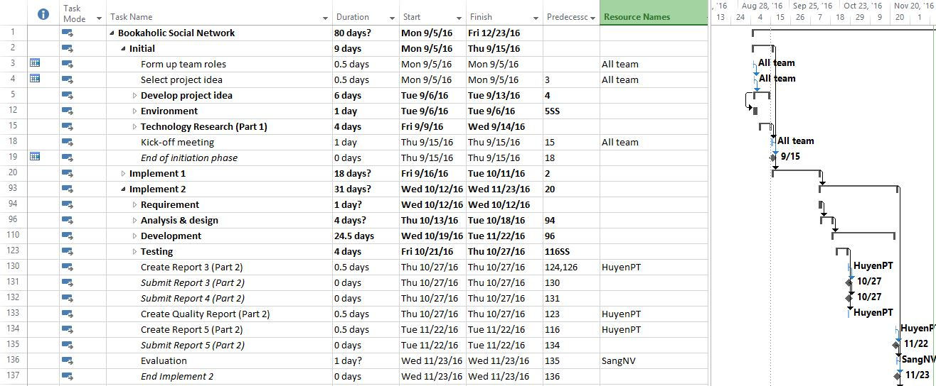
3. Project Schedule - プロジェクト計画
14

Slide 15
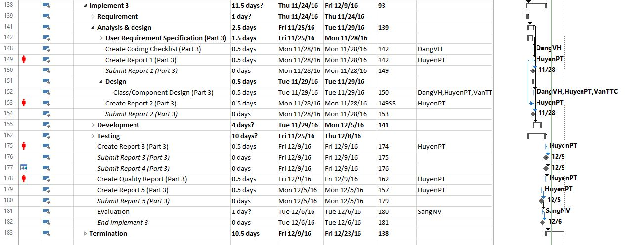
3. Project Schedule - プロジェクト計画
15

Slide 16
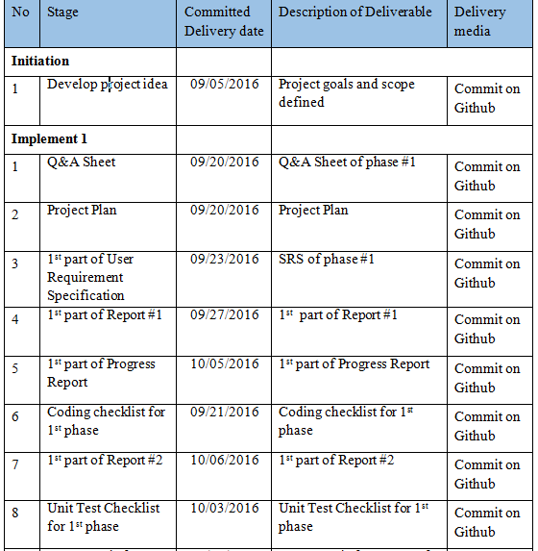
4. Objectives & deliverables -目標と成果物
16

Slide 17
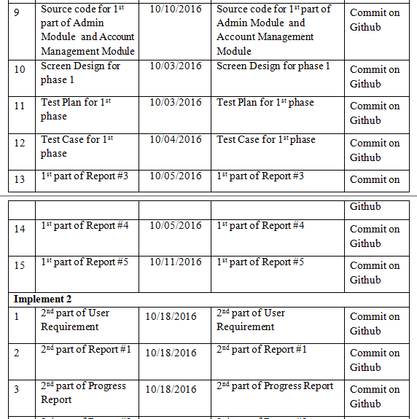
4. Objectives & deliverables -目標と成果物
17

Slide 18
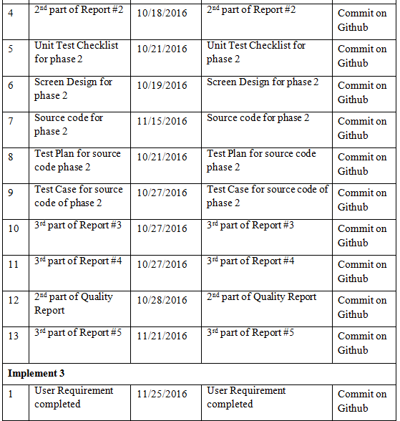
4. Objectives & deliverables -目標と成果物
18

Slide 19
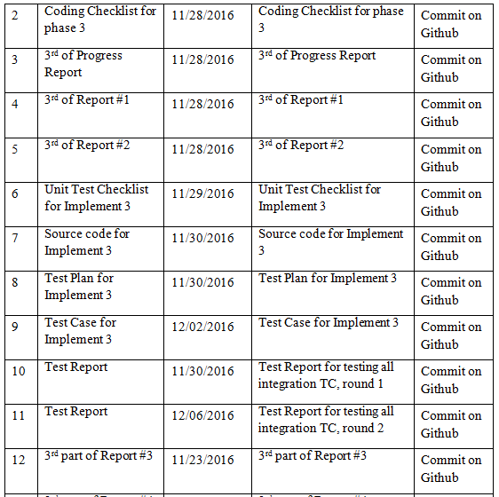
4. Objectives & deliverables -目標と成果物
19

Slide 20
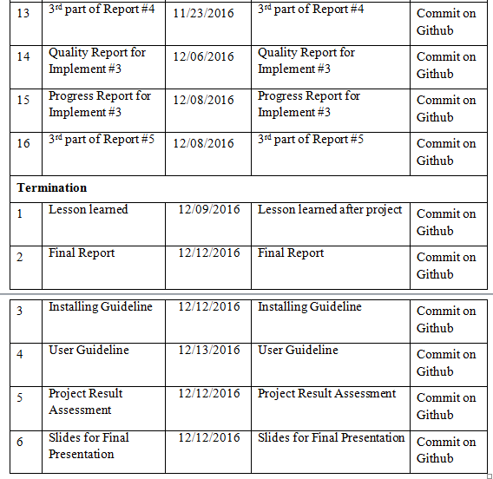
4. Objectives & deliverables -目標と成果物
20

Slide 21












5. Tools & Infrastructure - ツールと インフラストラクチャ
TOOLS
Tools for project management
Tools for developing
Microsoft Project
GitHub
Visual Studio
Google Chrome
Robo mongo
Tools for document
Tools for design
Microsoft PowerPoint
Microsoft Word
Microsoft Excel
Microsoft Visio
Astah
Photoshop
Brackets
< >
21

Slide 22
6. Risks management -リスク管理
No | Risk | Root Cause | Triggers | Avoidance plan | Contingency plan | Fallback plan
1 | Conflict among team members | Team member doesn't understand each others | Has issue inside team | Plan some team buildings to improve teammate | Have a meeting to resolve conflict problem | Switch member to other team.
2 | Requirement is changed after project is started | SRS not good (not realistic, not feasibility, not meet customer needs) | Customer (user) make change request. Or project team cannot develop the system as description in SRS. | Requirement should be paid a lot of attention. SRS should be reviewed carefully by PM and the supervisor. | With each requirement changes, the project team should have a meeting to analysis the change requests and take actions. | Re-estimate and update plan.
3 | Team member do not meet the deadline | Undisciplined and habit of team member, loose management | Have a deadline | Setting rule and minus of do not meet the deadline: punish money and named at meeting minute. | Punish the member do not meet the deadline. Working over time. | Ask for help from out of team, supervisors.
4 | Delivery project doesn’t meet requirement | Team member not understand requirement | Can't delivery project | Team lead have to review source code and follow requirement | Fix in next version | Extend deadline
リスク管理 - Risks management
22

Slide 23
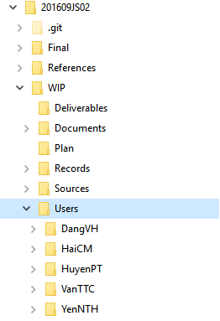
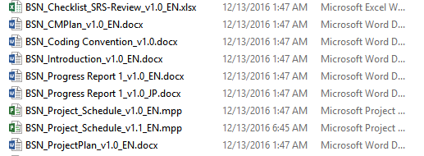
7. Configuration management - コンフィグレーション管理
Folder structure of project
Naming conventions
23

Slide 24












8. Communication management - コミュニケーション管理
Time:
Communication
8 hours/day
5 days/week
Location
Project Meeting
24

Slide 25
Software Requirements Specification

Slide 26
1. System Users - システムのユーザ
2. Functional Requirements - 機能要求
3. Non-Functional Requirements - 非機能要求
26

Slide 27


1. System Users - システムのユーザ
Guest
Reader/Author
Administrator
27

Slide 28
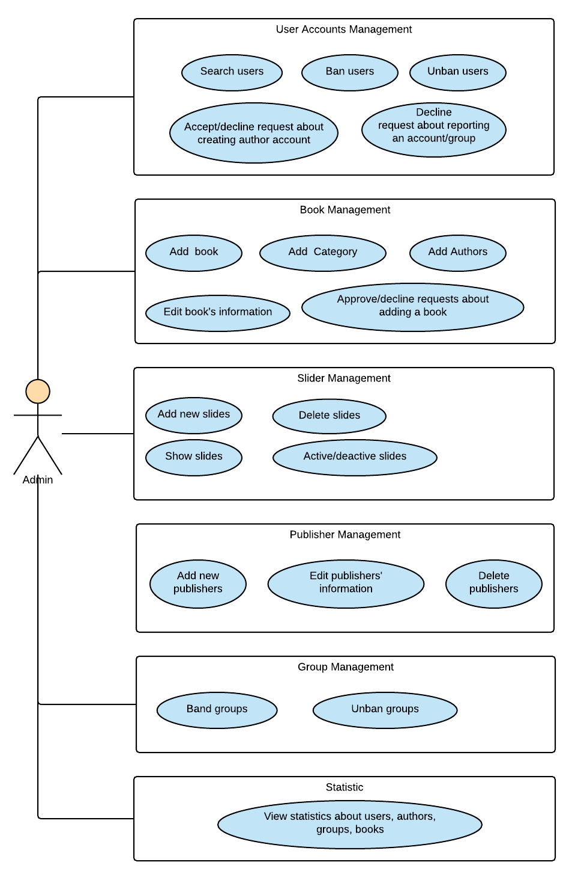
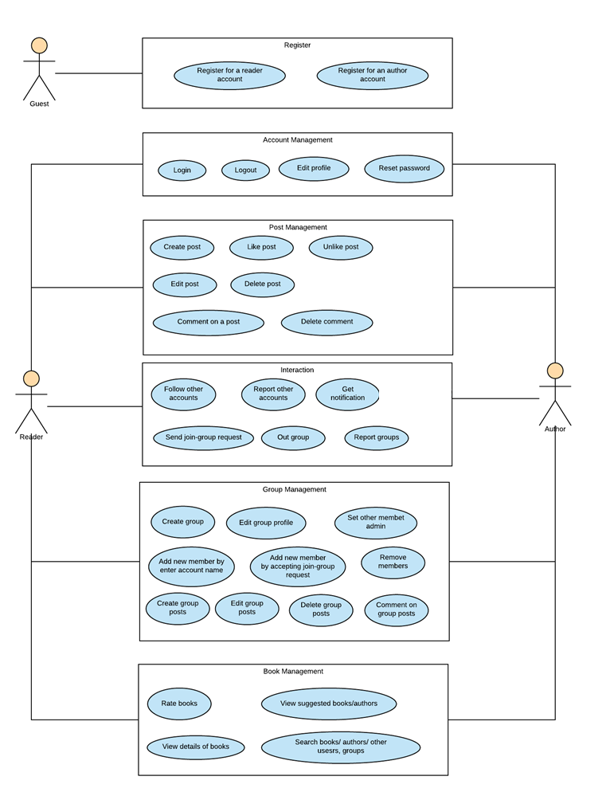
2. Functional Requirements - 機能要求
ユースケース図 – User case diagram
28

Slide 29
3. Non-Functional Requirements - 非機能要求
User Interfaces
Language is Vietnamese
Scalability
Take advantages of MongoDB in scaling size of the Project
29

Slide 30
Software Design Description

Slide 31
1. Technology & Reason - テクノロジーと理由
2. Architecture Representation - アーキテクチャ表現
3. Database Design - データベース設計
4. Detail Design - 詳細設計
31

Slide 32




1. Technology & Reason - テクノロジーと理由
Core Technology
ASP.NET MVC 5
MongoDB
Sub Technology
Bootstrap
SignalR
32

Slide 33
2. Architecture Representation - アーキテクチャ表現
33

Slide 34
3. Database Design - データベース設計
エンティティ関係図
Entity Relationship Diagram
34

Slide 35
3. Database Design - データベース設計
MongoDBのデータベース設計
MongoDB Database Design
35

Slide 36
4. Detail Design - 詳細設計
BSNの画面の流れ
BSN Screen Flow
36

Slide 37
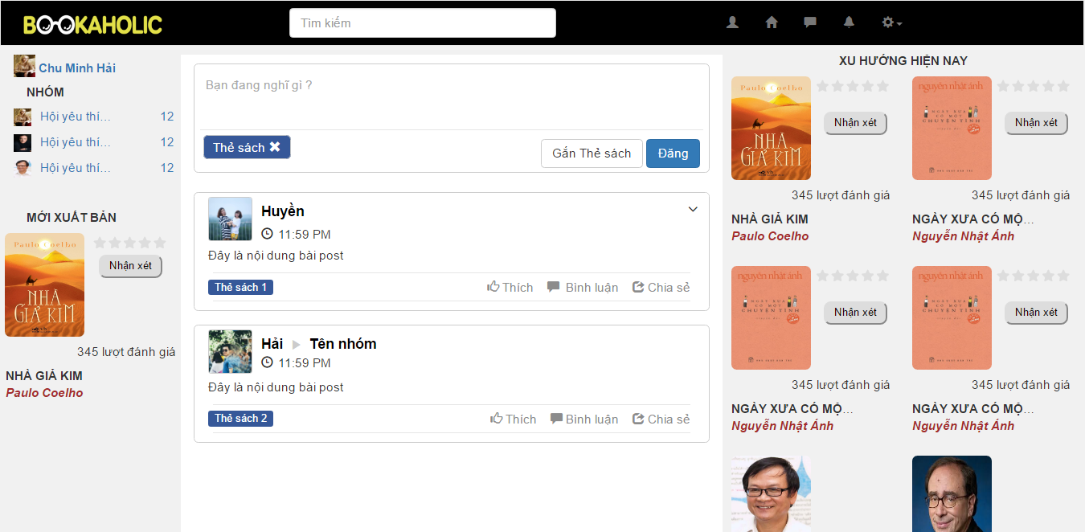
4. Detail Design - 詳細設計
Screen Design - 画面設計
ホームページの画面設計 – Homepage Screen Design
37

Slide 38
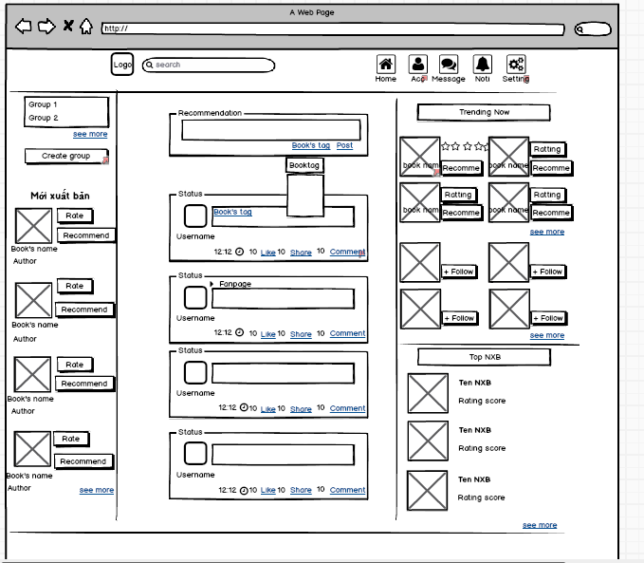
4. Detail Design - 詳細設計
Screen Design - 画面設計
ホームページの画面設計HTML – Homepage Screen Design by HTML
38

Slide 39
Quality Control

Slide 40
1. Review
レビュー
2. Testing
テスティング
1.1. Project Plan - プロジェクト計画
2.1. Test Process - テストプロセス
1.2. SRS - 要求仕様
2.2. Test Report - テストレポート
1.3. Design - 設計
1.3. Code - コーディング
1.4. Test Document - テスト
< >
35

Slide 41
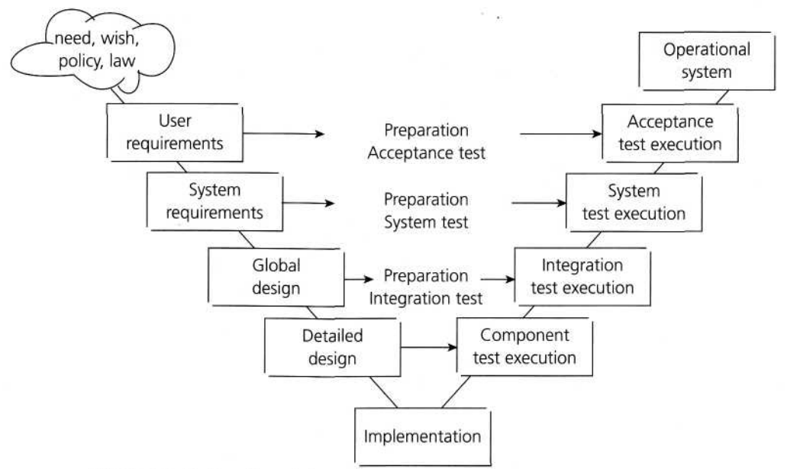
1. Review - レビュー
V-model process
41

Slide 42



1. Review - レビュー
自己評価
Self-review
ピアレビュー
Peer review
グループのレビュー
Group review
42

Slide 43
2. Testing - テスティング
43

Slide 44
Project Result

Slide 45
1. Result - 結果
45

Slide 46
1. Result - 結果
46

Slide 47
2. Limitation & Expectation - 制限と期待
Current Limitations
Expectation in Future
Website does not support Multilanguage
Support Multilanguage
Some screen cannot display well
Support view in Mobile and Tablet
Does not provide account registration by Gmail or Facebook account
Support more interact functions
Does not implement Full Text Searching.
47

Slide 48
3. Lessons Learnt - 学んだ教訓
Working in group and working individual.
Putting knowledge into practice.
Manage time and make the plan.
Be open to get the better opinions from other member.
Limit and resolve conflicts between members.
48

Slide 49
DEMO & QA

Slide 50
THANKS FOR WATCHING
BOOKAHOLIC
SOCIAL NETWORK

